Slide 1

How do you know you are really interested in it?
Or you just want to go out for some sports
Or you heard a new interesting place
Do you know where to go what to do?
If you want to go out for parkour
That’s why you need…
Do you know where to go?
Try to imagine…
2018.04
YU YENCHIA, Zhao Yun, Zhao Binqi

Slide 2
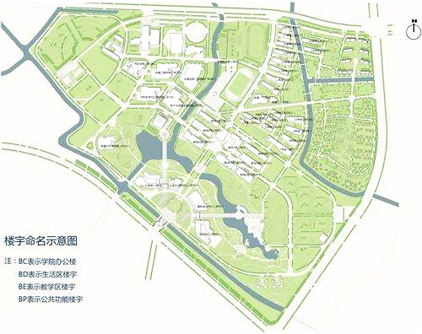
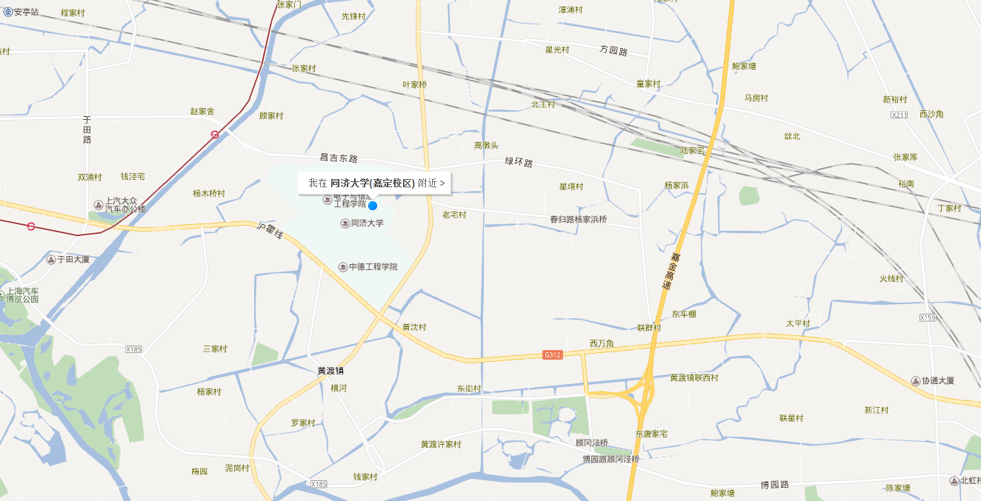
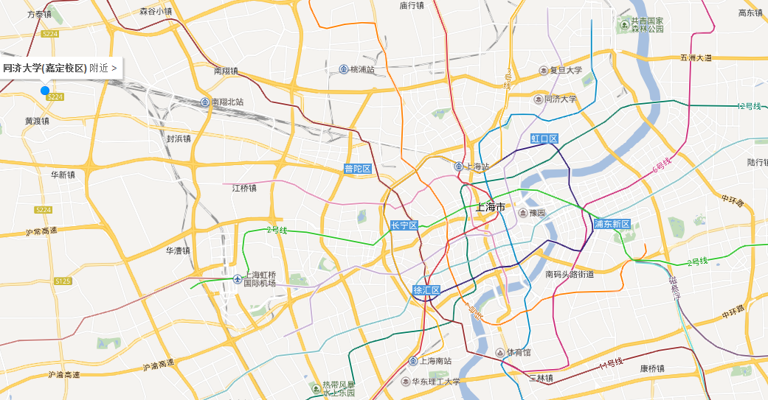
Part 1: Background
If you come here for the first time, how can you find fun here?
If you are familiar with this, how do you find more interesting paths?
So we decided to develop a new APP, enter the path, you will find a more interesting world！

Slide 3
What does it do:
record a single path
[they have walked, skateboarded or parkoured by redefining the roads’ name and function]
find those paths
[which have been redefined and follow them for themselves]

Slide 4
Spot data recording
Track recording
Path defining
Information sharing
Exploring
Navigating
Looking for fun
Making friends

Slide 5
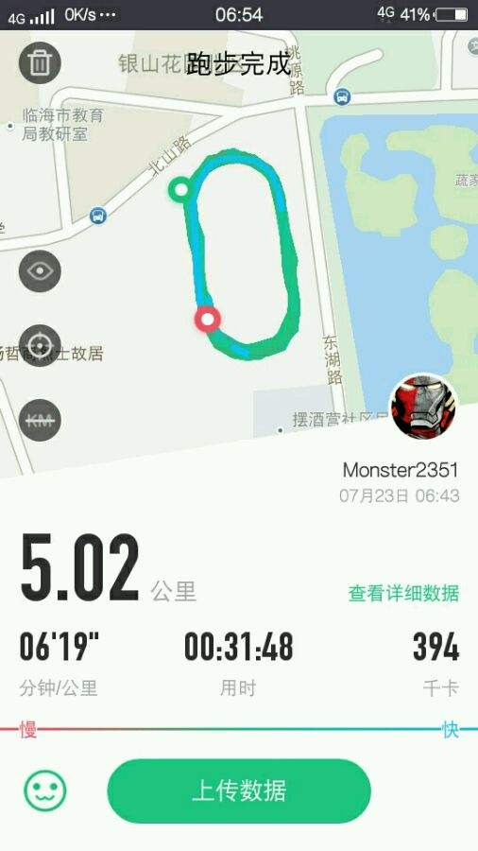
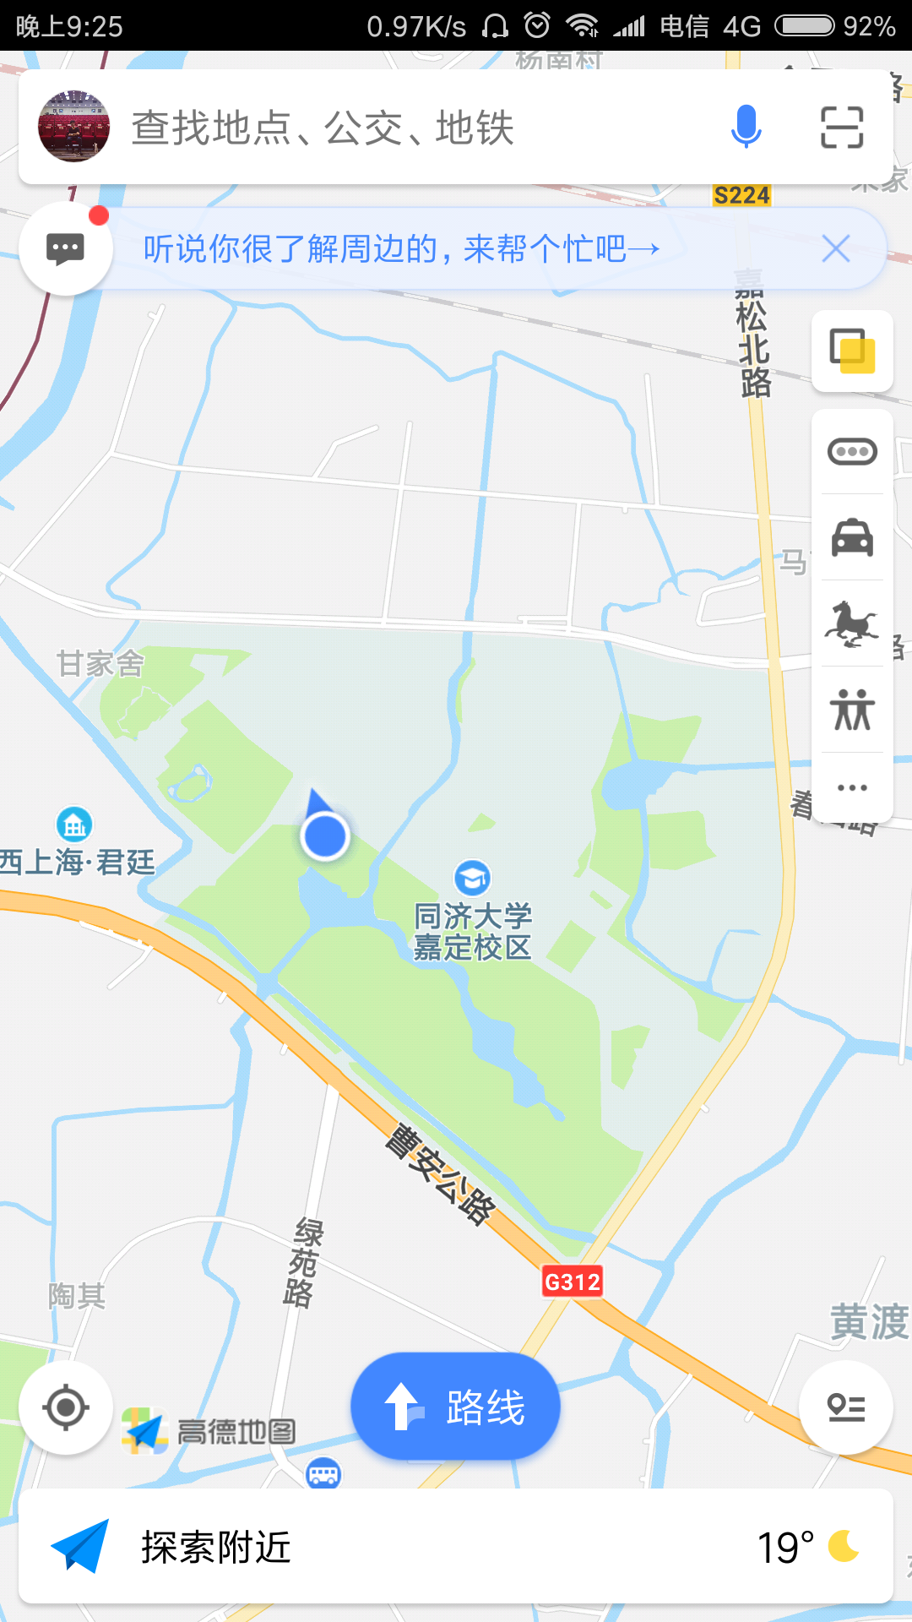
What’s the difference?
Just record
Just navigate
No tagging
Fixed route
Can’t record detail
Can’t save tracks
Can’t share the details
Isn’t personal
Makes no difference
No social network
Boring
Boring
PATH is the combination of sport and maps, but more socially-active, interesting and flexible!

Slide 6
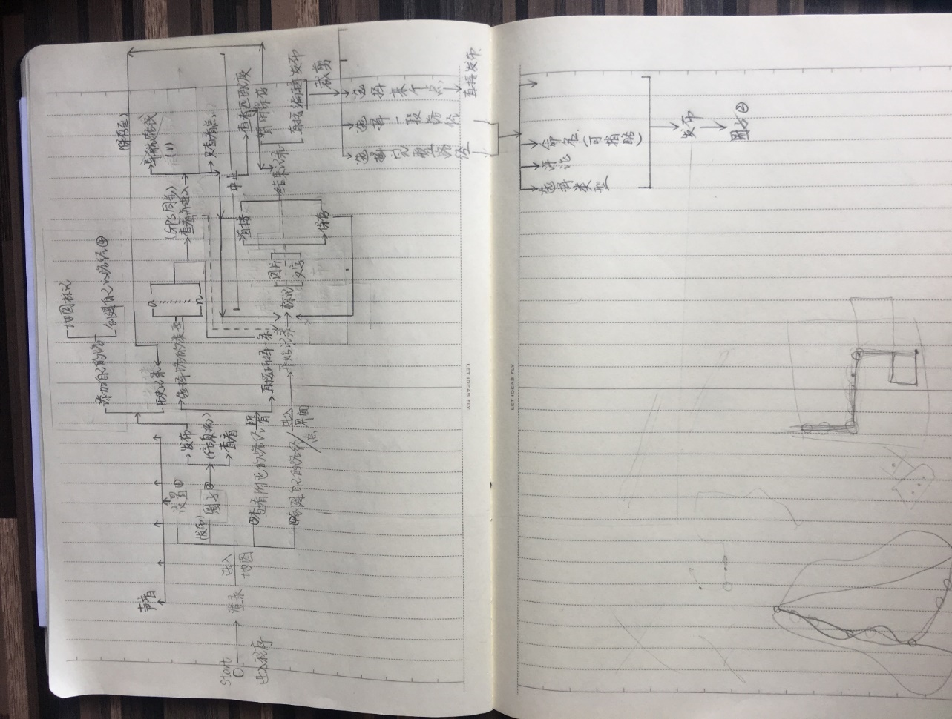
Part 2: APP UI design
Main function UI design

Slide 7
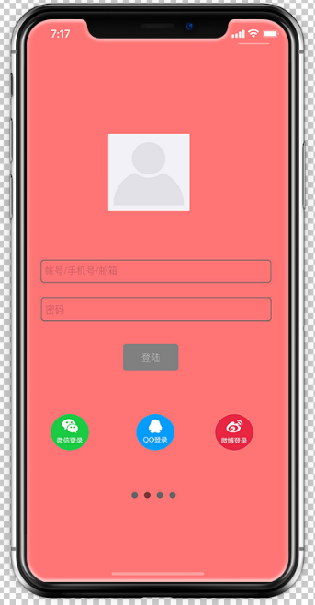
1) Log-in Page
Entire APP based on black, red, and white three color
Log in with multiple choices

Slide 8
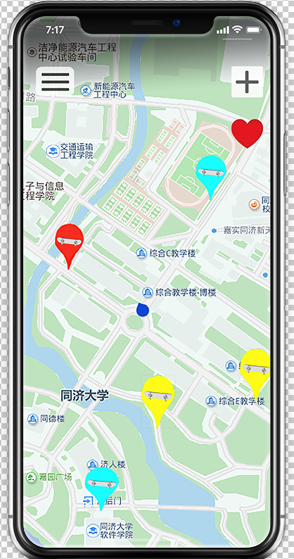
2)Main Interface
Background: real-time map
Colorful spots: redefined paths
Left rectangle: setting menu
“+”: create a new path
“♥”: preference

Slide 9
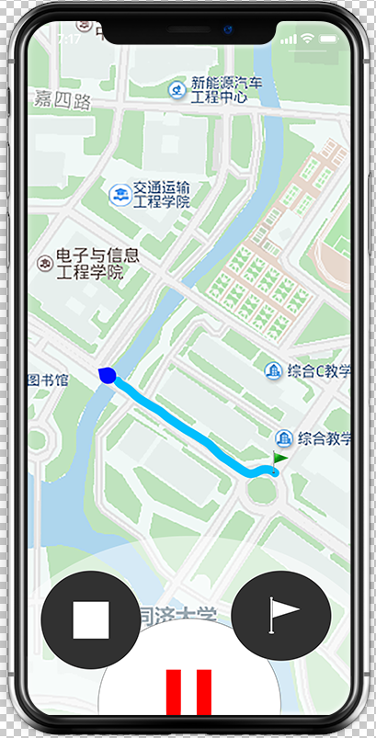
3)Create a Path
Record you real-time track
Tag spots that interested you and upload feelings and photos
Pause and start whenever you want

Slide 10
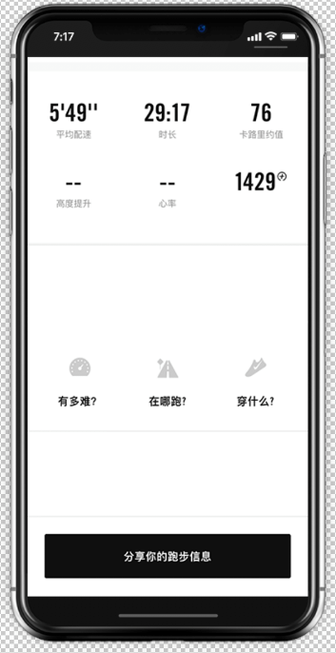
4)Publishing Page
See the data of this journey, including time, distance, speed and etc.
Define the name and the function of this path.
Add you words and photos.
Publish this unique path to everyone using PATH

Slide 11
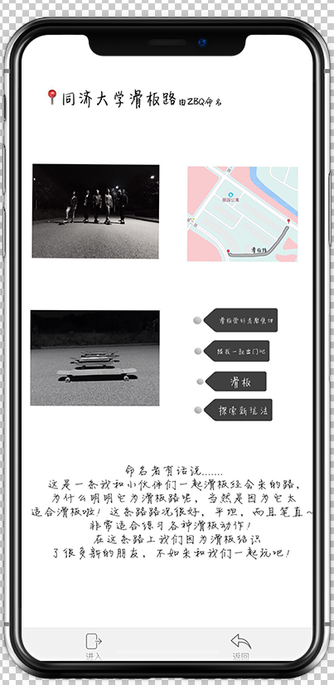
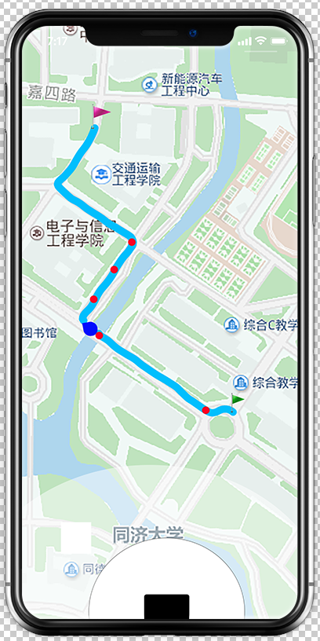
5) Follow a Path
See the detail of a path and decide whether to go through it or not
Fallow the track of creator, try to do what the creator used to do at the same place
See the interesting spots the creator set and share feeling whit them

Slide 12
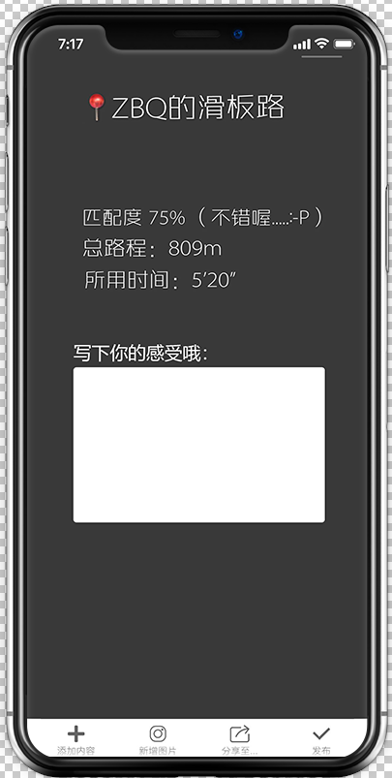
6)Analysis Interface
See the data of your journey
Compare the matching rate of your track with the creator’s
Share you feeling to those who have been through this path and make friends with them

Slide 13
Launching PATH
where you will find more interesting things and get to know more interesting souls...
In PATH
we let you have a taste of something different in the bland life by allowing the users give new names and classify the roads based on interest, and furthermore, experience the new fun of each different road, fall in love with a new world full of fun and challenges!

Slide 14
Concrete Jungle Explorers
钢铁森林探险家

